Slide 1


love the new

Slide 2

Table of Contents
Team Details
Problem Statement
What is your idea for the solution?
What domains does it address? What is the impact?
What makes your solution/idea innovative?
Technologies Leveraged
Technical Feasibility
Financial Feasibility
Testimony
Elevator Pitch – 1 to 2 mins

Slide 3
Team Details
Team Name | Member Names | Education Institute Name
InnovisionSquad | Krishna Aute | Deogiri Institute of Engineering & Management Studies, Aurangabad
 | Shubham Pitekar | Deogiri Institute of Engineering & Management Studies, Aurangabad
 | Dayeeta Chakravorthy | Deogiri Institute of Engineering & Management Studies, Aurangabad
 | Siddhi Tribhuwan | Deogiri Institute of Engineering & Management Studies, Aurangabad
 | Samruddhi Giri | Deogiri Institute of Engineering & Management Studies, Aurangabad

Slide 4

Problem Statement
Inadequate e-waste disposal practices have reached critical proportions in India, with a staggering 1.71 million metric tons of electronic waste accumulating annually. This alarming figure underscores a pressing environmental challenge that demands immediate attention.
The primary issue lies in the difficulty individuals and corporations face when trying to locate reliable e-waste collection facilities. This scarcity of accessible and trustworthy disposal avenues exacerbates the problem, leading to haphazard and improper disposal methods.
In a rapidly technologizing world, the correct disposal of electronic waste has become an imperative. The current scenario not only poses environmental risks but also impacts public health and safety. It is evident that a systematic approach to e-waste management is urgently required.
Domain : Sustainability & Green Technology / Environment
Electronic Waste

Slide 5

What is your idea for the solution?
Solution:
In response to the critical issue of e-waste disposal, we present an
Integrated web platform. This solution is characterized by:
User-Friendly Interface: Our platform boasts an intuitive design, ensuring a seamless experience for all users.
Advanced Technology Stack: Leveraging cutting-edge technology, like Nextjs, Expressjs/Nodejs, MongoDB, MapBox map API our platform ensures robust functionality and efficiency.
Key Features:
User Education: Empowering users with knowledge about e-waste disposal best practices.
Booking System: Enables users to easily schedule pickups for their electronic devices, fostering a user-friendly experience.
Location-Based Services- Helps users locate and connect with nearby recycling facilities, promoting accessibility and convenience.
Educational Blog Section- Provides a valuable resource for users to access information about the environmental impact of e-waste and sustainable consumption practices.
Repository of Rules and Regulations- Acts as a centralized source for users to stay informed about the legal frameworks governing e-waste management.
E-Waste Recycling Platform

Slide 6
What domains does it address? What is the impact?
Domains Addressed:
Environmental Sustainability: Mitigates e-waste accumulation through responsible disposal practices and recycling initiatives.
Technology and Innovation: Utilizes cutting-edge technology, such as a user-friendly interface and an interactive chatbot, to revolutionize e-waste management.
Education and Awareness: Emphasizes user education, raising awareness about the importance of proper e-waste disposal and recycling.
Business and Industry: Offers a centralized platform for companies to efficiently manage e-waste disposal processes, supporting sustainable production practices.
Impact:
Environmental: Significantly reduces the environmental impact of e-waste accumulation by promoting responsible disposal practices and recycling, contributing to a more sustainable environment.
Economic: Creates a market for recycled electronic components and fosters responsible production practices, potentially stimulating economic growth.
Transparency and Accountability: Encourages e-waste reporting and auditing, promoting transparency and accountability in waste management efforts.
Empowerment: Empowers individuals and businesses to make informed and responsible choices in e-waste disposal, contributing to a cleaner and more sustainable future.
Innovation and Technology Adoption: By leveraging cutting-edge technology, our solution encourages the adoption of innovative waste management practices.

Slide 7
What makes your Solution/Idea innovative?
Bridging User-Facility Gap:
Fills the crucial gap between users and e-waste facilities, streamlining the disposal process.
Revolutionary E-Waste Booking System:
Introduces a pioneering booking system enabling facilities to verify and issue credits based on valuable metals
in electronic devices.
Real-time Facility Verification:
Utilizes real-time verification processes to ensure facilities meet quality and compliance standards.
Comprehensive Facility Reviews:
Empowers users with essential insights through detailed facility reviews.
Efficient Admin Panel:
Swiftly addresses complaints and offers a comprehensive view with detailed reports.
Sustainable Feedback Loop:
Establishes a feedback loop between users and facilities to encourage continuous improvement and sustainable practices.
Dynamic User Rewards System:
Introduces a dynamic rewards system based on responsible disposal behaviour, fostering long-term user engagement.

Slide 8









Technologies Leveraged
• Frontend Development:
• React/Next.js: Utilized for building the user interface, providing a responsive and interactive experience. And tailwind CSS for styling.
• Backend Development:
• Express.js: Employed to create a robust and efficient backend to handle server-side logic.
• Database Management:
• MongoDB: Chosen for its flexibility and scalability, facilitating efficient data management.
• Geolocation Integration:
• Map Box Maps API: Integrated to enable precise location tracking of nearby e-waste facilities.
• Security Measures:
• Advanced Security Protocols: Employed to safeguard user data and ensure data privacy and integrity.
Tech Stack

Slide 9
Technical Feasibility
Advanced Technology Stack: Utilizes React/Next.js, Express.js, and MongoDB, showcasing a robust and modern tech foundation.
API Integrations: Seamlessly incorporates Google Maps API for precise geolocation of nearby facilities.
Blockchain Integration: Ensures transparent tracking of e-waste, emphasizing data integrity and security.
Real-Time Verification: Capable of verifying facilities in real-time, meeting quality and compliance standards.
Security Measures: Implements advanced protocols for safeguarding user data, ensuring privacy and integrity.
Scalability Considerations: While not explicitly mentioned, the technology choices and architecture suggest potential for scalability with appropriate design considerations.

Slide 10
Financial Feasibility
1. Cost-Effective Technology Stack: By leveraging open-source technologies and frameworks like React/Next.js and Express.js, we keep development costs low while ensuring high-quality performance.
2. Scalable Architecture: The platform's design allows for seamless scaling, minimizing additional infrastructure costs as user base grows.
3. Potential Revenue Streams: Opportunities for revenue generation include premium features, strategic partnerships with e-waste facilities, and potential subscription models for advanced services.
4. Grant and Funding Opportunities: Explore grants and funding programs aimed at supporting sustainable and innovative solutions in the e-waste management sector.
5. Economic Impact: By stimulating a market for recycled electronic components, the platform has the potential to contribute to economic growth in the e-waste recycling industry.
6. Operational Efficiency: Streamlined processes, including real-time verification and AI-powered assessments, optimize resource utilization and contribute to cost efficiency.
7. ROI for Facility Owners: Facility owners can benefit from increased business through the platform, potentially leading to a positive return on investment in their e-waste disposal operations.

Slide 11
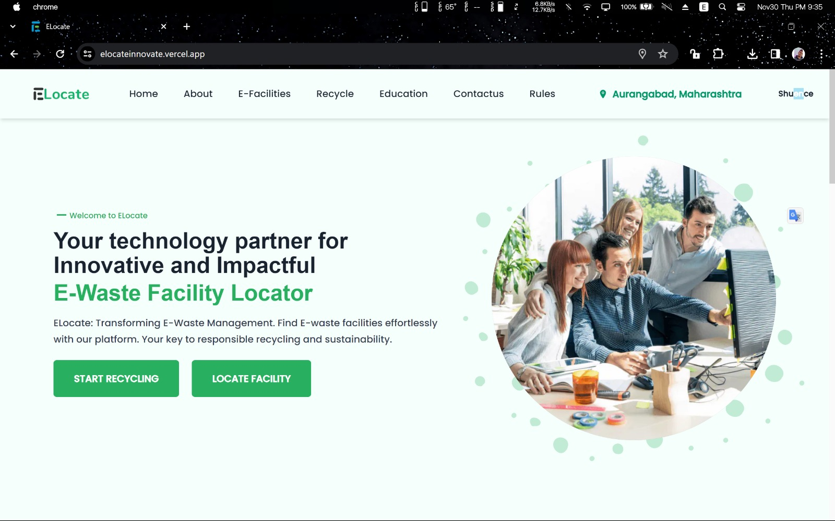
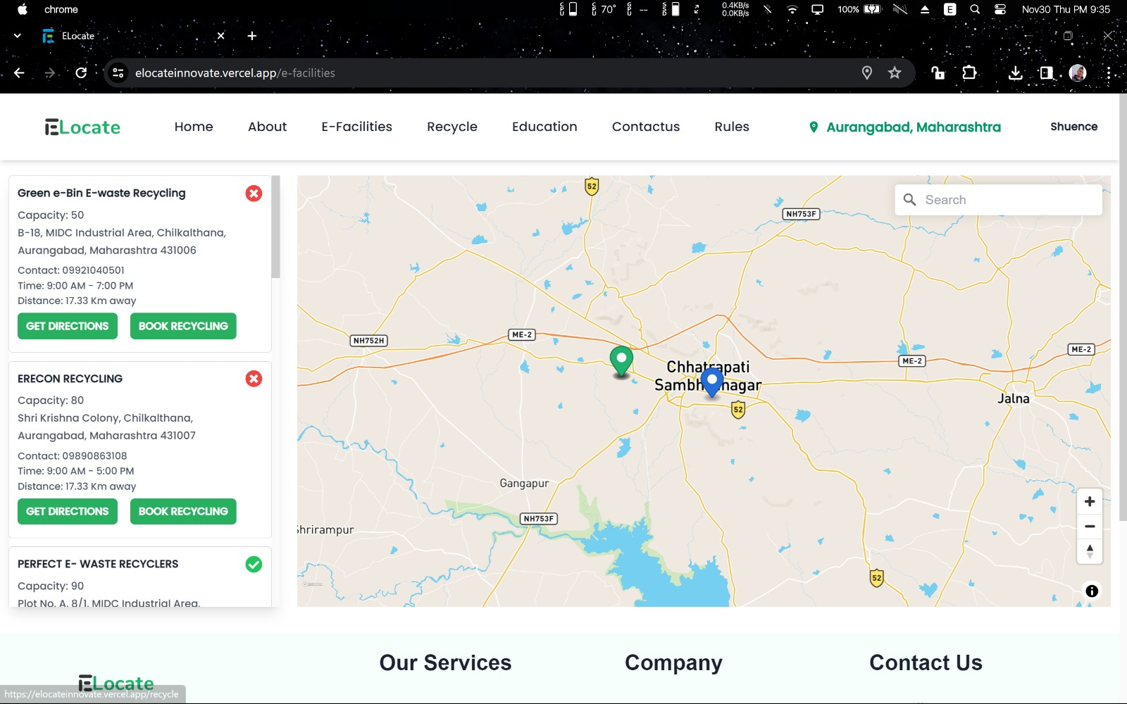
Screen shot of prototype

Slide 12
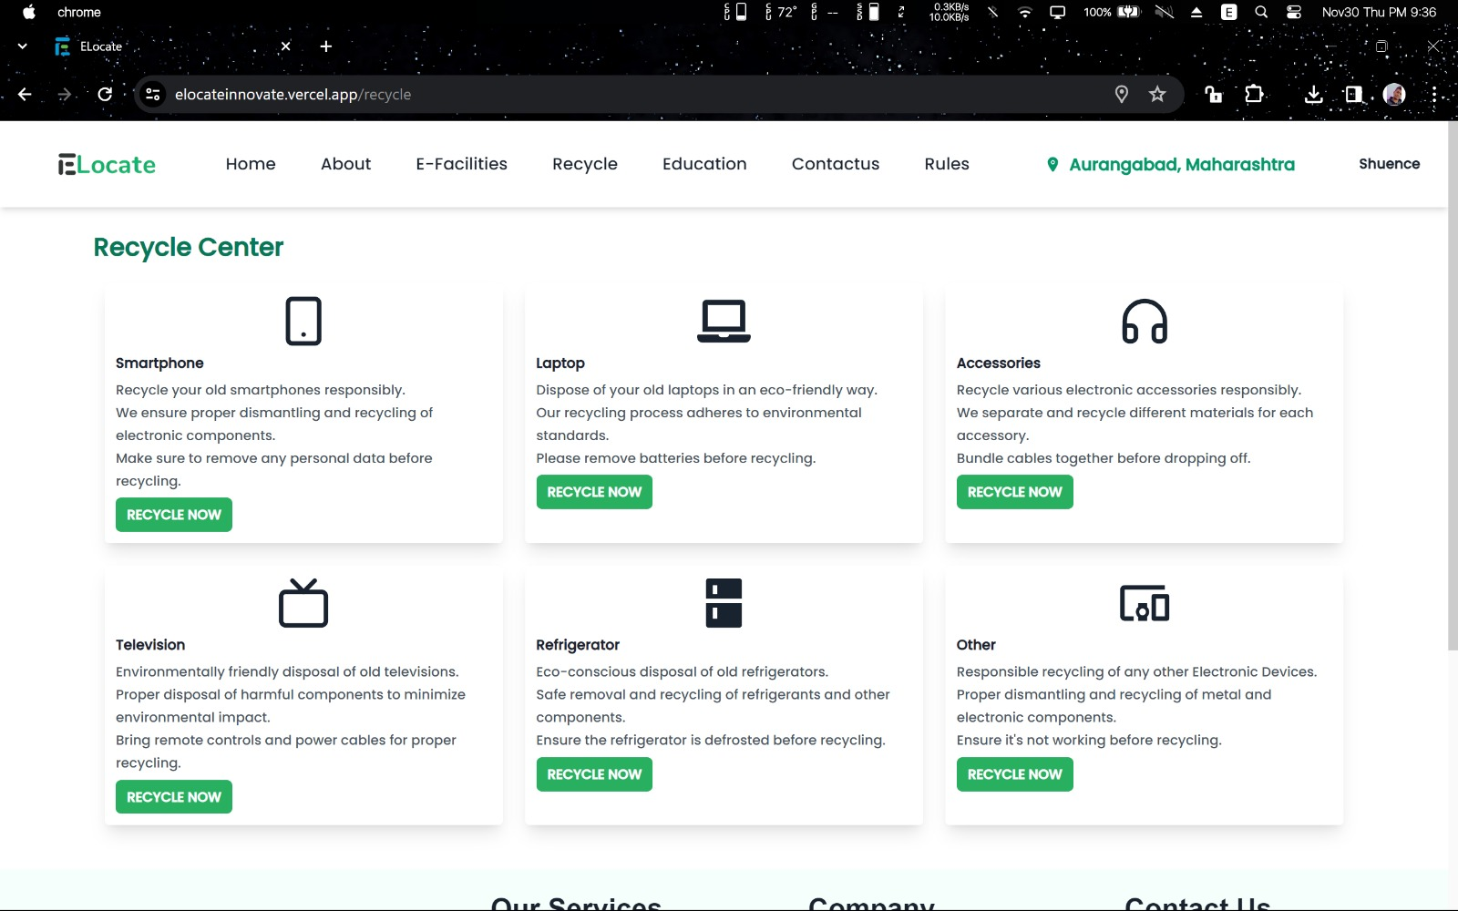
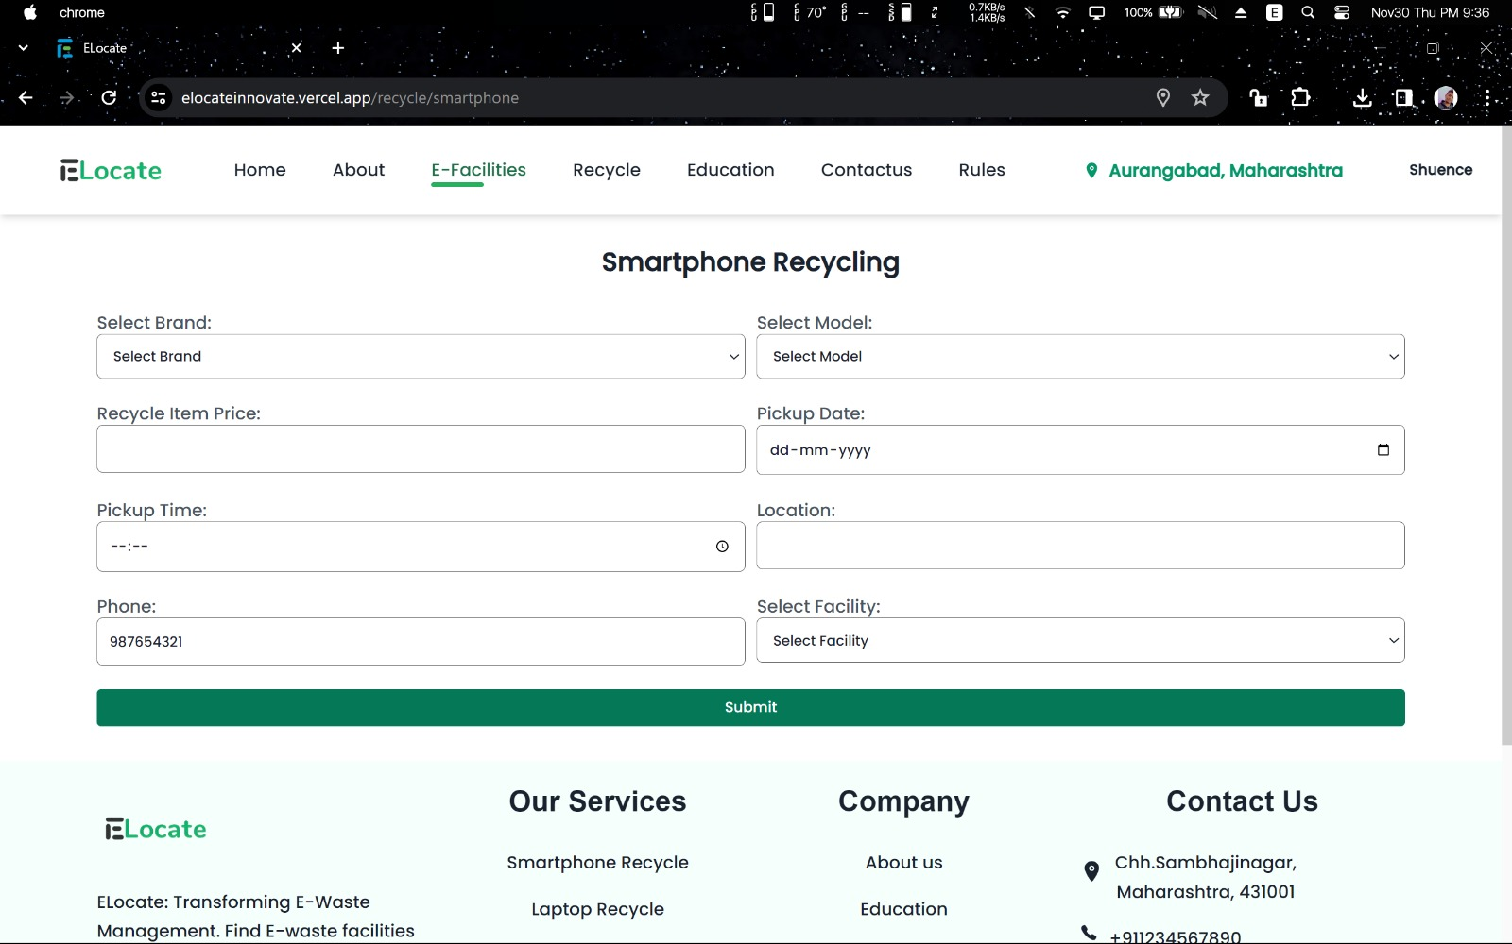

Slide 13
Conclusion
The conclusion marks the culmination of the "E-Waste Management System" project, summarizing key findings, achievements, and the impact of the system on e-waste management practices. In essence, the conclusion provides a reflective summary of the E-Waste Management System project, celebrating achievements, recognizing challenges addressed, and looking forward to the continued positive impact on e-waste management

Slide 14
Elevator Pitch (1-2 mins)
InnovisionSquad presents the E-Waste Locator Platform, revolutionizing e-waste disposal. Our user-friendly interface and cutting-edge technology bridge the gap between users and e-waste facilities, streamlining the disposal process.
Key Features :
Revolutionary Booking System: Verify and issue credits based on valuable metals in electronic devices.
Real-time Facility Verification: Ensures quality and compliance standards.
Comprehensive Reviews: Empowering users with essential insights.
Efficient Admin Panel: Swiftly resolves concerns for smooth operations.
Impact:
Reduce the environmental impact of e-waste accumulation. Join us in building a cleaner and more sustainable future!
Elevate e-waste management with InnovisionSquad!

Slide 15
Thank You !

